Slide 1
Analysis on the Integrated Development of Traditional Information and Rural Tourism
Name: M.A.B.Siddique Sanjan
ID:19201068
Section:01
Course:CSE438

Slide 2
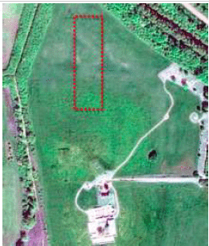
Introduction:
Remote sensing image data analysis plays a crucial role in the integrated development of traditional information and rural tourism. This presentation explores the methodology, data transmission model, and the importance of remote sensing integration in rural tourism development.

Slide 3
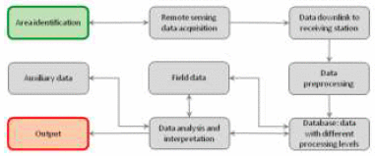

Remote Sensing Image Collection and Processing
1
Spectral Features Extraction
Utilizing the finite ridge wavelet transform for multi-level decomposition, we can obtain signals at different scales to enhance the contrast and clarity of remote sensing images.
2
Classification Methods
Explore both supervised and unsupervised classification methods to effectively categorize objects within remote sensing images. Histogram equalization can further enhance the separation of distinct groups.
3
Unified Processing Platform
Develop a virtual processing platform that provides a comprehensive and efficient environment for the processing of remote sensing data, ensuring consistency and accuracy in analysis.

Slide 4
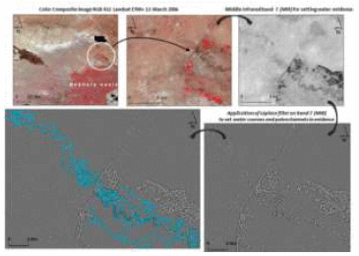
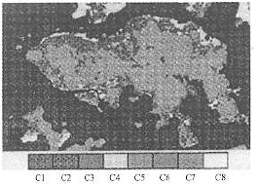
Remote Sensing Data Transmission Model
Structural Features
Ruffles, faults, and linear structures contain valuable information for various applications such as thermal motion, liquid matter, carbohydrates, and mineral detection.
Unsupervised Classification
The arrangement of codeword length and symbol probability influences the averaging algorithm within unsupervised classification, allowing efficient compression of data.
Mosaicing Challenges
Maintain consistency and address dislocation caused by tone adjustment and geometric correction during the mosaicing process, ensuring accurate interpretation and analysis.

Slide 5
Integrated Development of Traditional Information and Rural Tourism
1
Sightseeing Agriculture
2
Ancient Villages
3
Rural Tourism Potential
With tangible and intangible cultural heritage, ancient villages are valuable cultural tourism resources that provide glimpses into a country’s rich historical memories and cultural relics.
Sightseeing agriculture, located adjacent to cities, showcases its ecological and cultural characteristics, offering a unique experience for tourists and promoting sustainable rural development.
By integrating remote sensing image analysis, we can gain insights into the development potential of rural areas, fostering tourism growth while preserving cultural and environmental integrity.

Slide 6
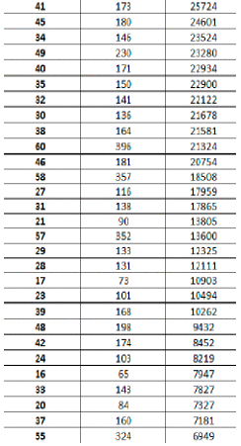
Simulation and Verification
Image Algebraic Operations
Results and Visualizations
Figure 6: Simulation Output
Apply algebraic functions to data file values, allowing for the simulation of complex scenarios based on the proposed model for accurate analysis and verification.
Explore the results of the simulation, recognizing the potential of remote sensing image data analysis and its ability to present complex information in a visually compelling manner.
Visual representation of the simulation results, showcasing the effectiveness and robustness of the proposed model for integrated development analysis.

Slide 7

Conclusion and Prospect
This analysis demonstrates the effectiveness of utilizing remote sensing image data analysis in the integrated development of traditional information and rural tourism. By overcoming the limitations of traditional methods through the finite ridge wavelet transform and feature extraction, we have paved the way for further exploration and integration of different applications within the proposed model.

Slide 8
Thank You!

